Slide 1

ANALYZING THE RELATIONSHIP BETWEEN SOCIAL MEDIA USAGE AND ACADEMIC PERFORMANCE OF STUDENTS
-Sindhu Poloju

Slide 2


Purpose of the Study
This research purpose is to investigate the affect that exists between the time spent on Instagram and Academic Performance of Indian Graduate students at Pittsburg State University.

Slide 3
Significance of the Study
Students will understand the importance of maintaining healthy digital habits while interacting with Instagram and other similar applications.
Educational institutions will understand the impact of the time spent on Instagram on students and, hence, develop programs and awareness that promote healthy approaches.
This study's findings can guide future research on how various social media platforms, content types, and strategies affect academic performance.

Slide 4

Research Questions/Hypothesis
What are the impacts of time spent on Instagram on the Indian Graduate student grades at Pittsburg State University?
Null Hypothesis: There is no correlation between the time spent on Instagram and the academic performance of Indian Graduate students at Pittsburg State University.
Alternative Hypothesis 1: There is a positive correlation between the time spent on Instagram and the academic performance of Indian Graduate students at Pittsburg State University.
Alternative Hypothesis 2: There is a negative correlation between the time spent on Instagram and the academic performance of Indian Graduate students at Pittsburg State University.

Slide 5
Definition of Terms
Social Media- This digital technology allows individuals to share information (Danquah et al., 2018).
Instagram- This is a social media application that individuals use to share information (Huang & Su, 2018).
Impact- the effect or influence caused by something or a situation (Danquah et al., 2018).
Grade- this is an educational rank that specifies how an individual has achieved in a subject or course (Ersoy & Arseven, 2021).
Students- an individual who is enrolled in a learning institution (Ersoy & Arseven, 2021).

Slide 6

Limitation of the Study
This research is limited to only Indian graduate students at Pittsburg State University.
The research study is restricted to only age group of 21-27 years.
The participants in this study are limited to only 218 people.
The participants can adjust their answers to fit societal expectations.
The study will not address other variables such as family history, and other activities that could affect their academic performance.

Slide 7
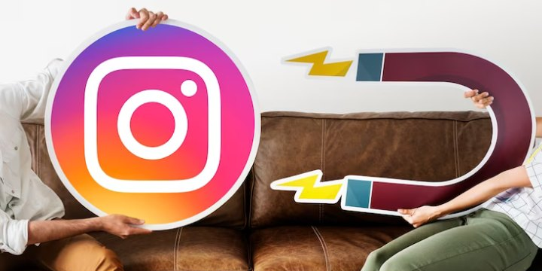

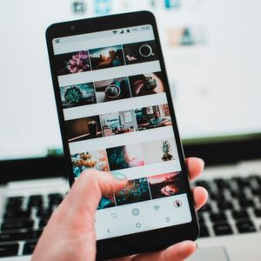
Literature Review
Junco et al. (2007) examined the relationship between college students' use of online social network sites, specifically Facebook, and the accumulation of social capital, highlighting the benefits derived from "Friends" on the platform.
Islam et al.(2018), The study explores social media's impact on academic performance, emphasizing monitoring and educational use to mitigate negative effects.
Kubley et al.(2001), The study investigates the correlation between social media usage and academic performance among medical undergraduates, revealing a negative impact on academic outcomes.
Barton et al.(2018), the article examines the relationship between social media usage and academic performance, considering factors such as attention, motivation, and GPA, while highlighting mixed findings in existing research.
Wang et al.(2015), The literature review explores the impact of social media overload, including information, communication, and social overloads, on technostress, exhaustion, and academic performance among university students, using the stressor-strain-outcome model.
This Photo by Unknown author is licensed under CC BY-NC.

Slide 8

Most Cited Authors
Junco's (2012),
Barton et al. (2018), and
Wang et al. (2015).

Slide 9

What Authors Agreed and Disagreed
Agreed
Junco's (2012) research found that Facebook negatively impacted academic achievement based on self-reported data.
Barton et al. (2018) found that social media usage had a detrimental impact on academic performance. In addition, social media was identified to be a predictor of GPA.
Disagreed
Wang et al. (2015) found no significant difference in grade point average (GPA).

Slide 10

Research Design
Methodology: Quantitative Research Method
Research Design: Descriptive Design
Variables:
Independent variable – Time Spent on Instagram
Dependent variable- Grades of the Students

Slide 11
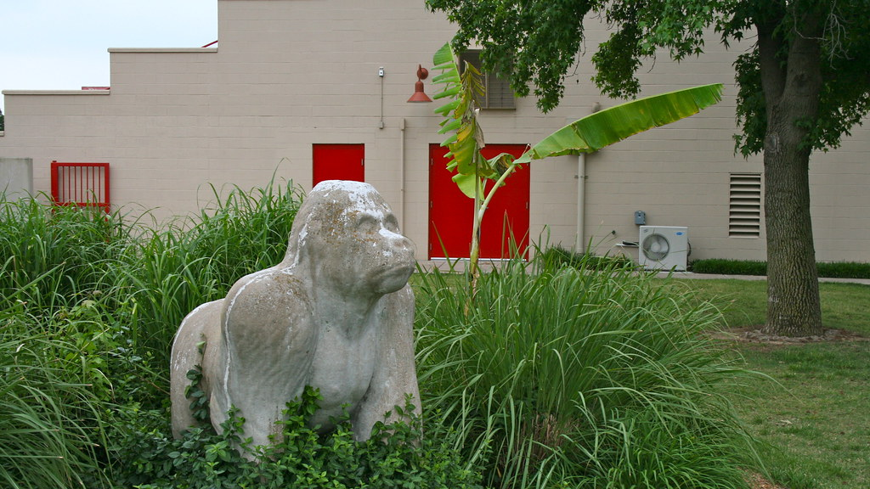
Population: Indian Graduate students at Pittsburg State University- 500 Sample Size: 218 participants, age 21-27years.
Sampling Technique: Convenience Sampling
Population and Sample Size
This Photo by Unknown author is licensed under CC BY-SA-NC.

Slide 12
Role of the Researcher
Frame survey questions aligning with study objectives to assess Instagram usage and academic performance.
Collect data from participants' responses through surveys distributed to Indian graduate students.
Analyze findings and clean up data to determine the relationship between Instagram usage and grades.
Ensure ethical conduct by obtaining approval, informed consent, and protecting participants' rights.
Validity and Reliability
Validation and reliability will be utilized to achieve trustworthiness and consistency in findings.
Validation Technique: Internal Validation
Reliability Technique: Internal Consistency Reliability

Slide 13
DATA COLLECTION METHOD
Purpose: Analyzing the relationship between social media usage and academic performance of the students
Obtaining Permissions
Take IRB approval to conduct the research
Gathering information from registrar office at PSU for those who have enrolled Graduate Program.
Choosing participants using convenience sampling
Sending a survey link with questions through the survey monkey through the questionnaire form
Collect the responses through Survey Monkey.
Analyze the data through the number of responses obtained for each option of every question
Represent the obtained data in a bar graph.
IF NO: Creating a post or advertisement in university student communication groups or use social media to approach participants.
If yes, students should participate in research studies

Slide 14
Data Analysis Procedure
Collect Data in Excel Sheet
Represent Data Using Graphs
Draw Final Conclusion from Analysis
Examine Participants' Instagram Usage
Draw Conclusions from Each Survey Question

Slide 15


